Slide 1



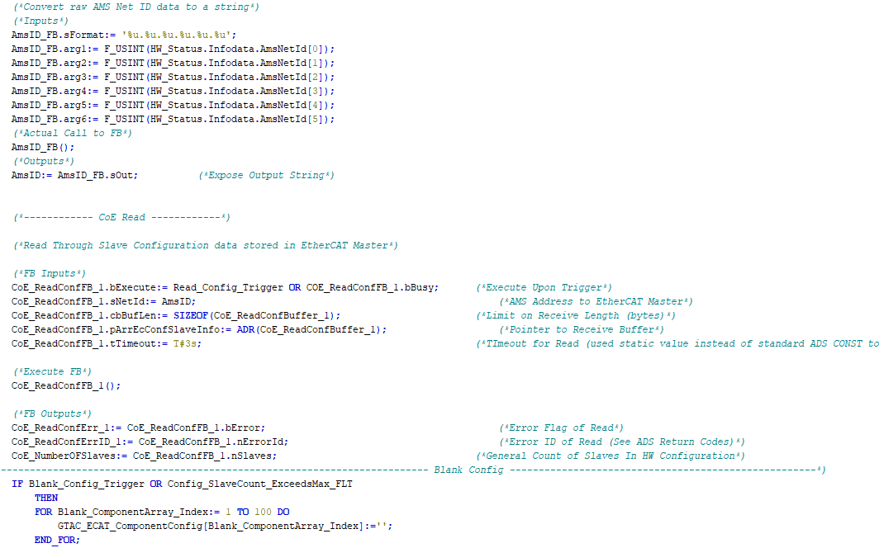

Controls Training
Part 3:
Framework Overview – UI

Slide 2
BUT FIRST
Why are we Migrating

Slide 3

WHY
A look licensing at costs
IWS Licensing Costs
TcHmi Licensing Costs
$4,000 CDN per screen runtime license cost
(Maximum 16,000 tags)
$4000 per programmer for development license cost
$3,000 CDN for up to 10 screens
(Unlimited tags)
No development License required

Slide 4
WHY
Translated Savings
$1,000 CDN savings for a 1 Screen Machine
$5,000 CDN savings for a 2 Screen Machine
$9,000 CDN savings for a 3 Screen Machine
$13,000 CDN savings for a 4 Screen Machine
Note: There will be some additional cost savings associated with this migration as well. We will explore them later in this session.

Slide 5
WHY
Side by Side Comparison
Proprietary Development Environment and file system
Not well suited to GitHub and collaborative development
Proprietary RT Engine
Out of date quasi - VBA scripting
License required for development and runtime
Developed in MS Visual Studio, text - based file system, built on modern web technologies
GitHub built-in for collaborative development
Web based and browser viewed
Open HTML/CSS/JS environment
Licensing costs only apply to runtimes

Slide 6
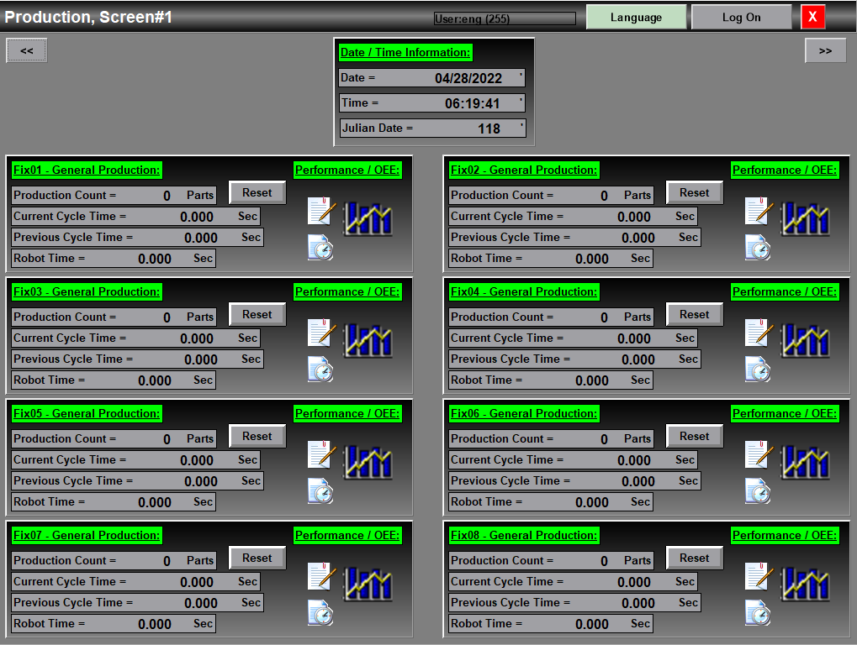
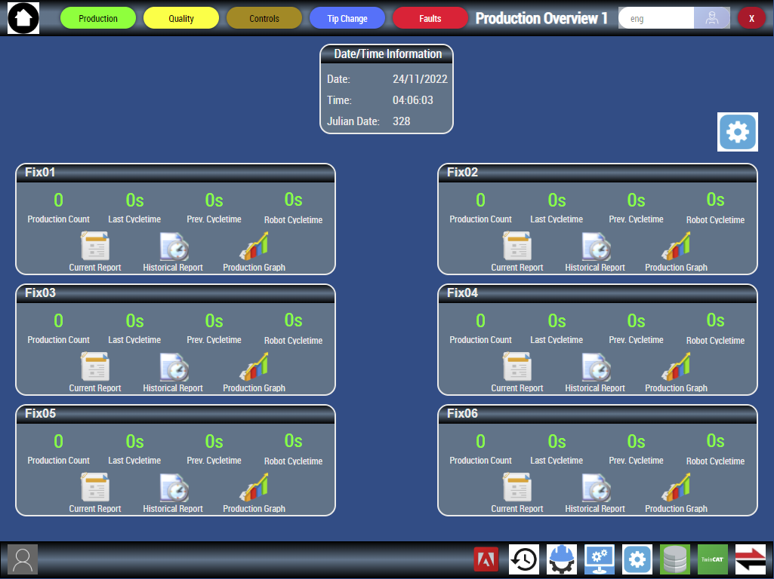
Old IWS Production Screen
New TcHmi Production Screen
More Modern Look and Feel

Slide 7
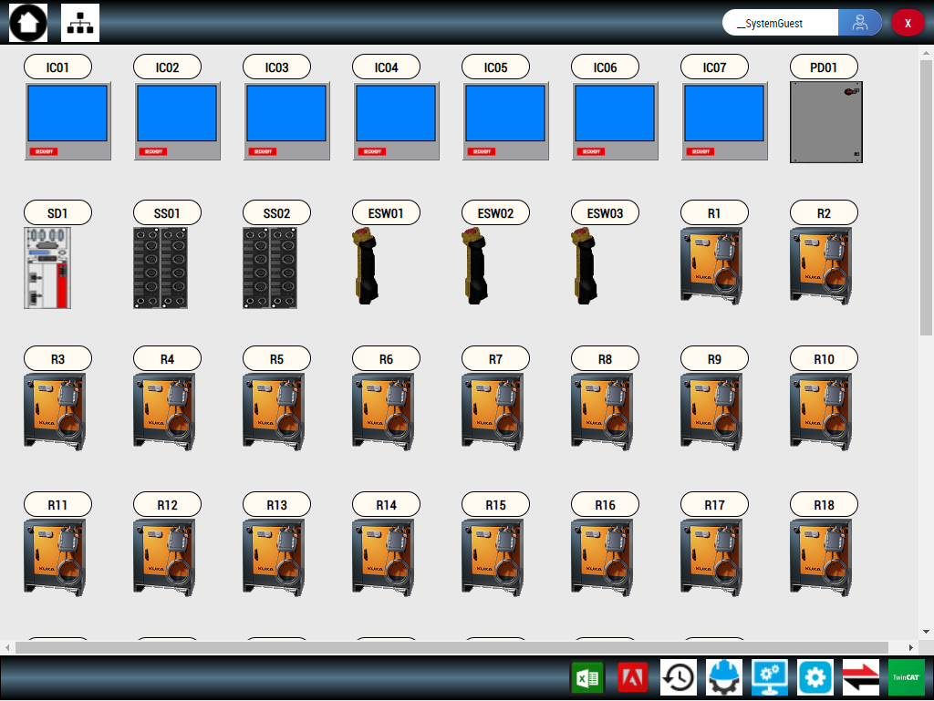
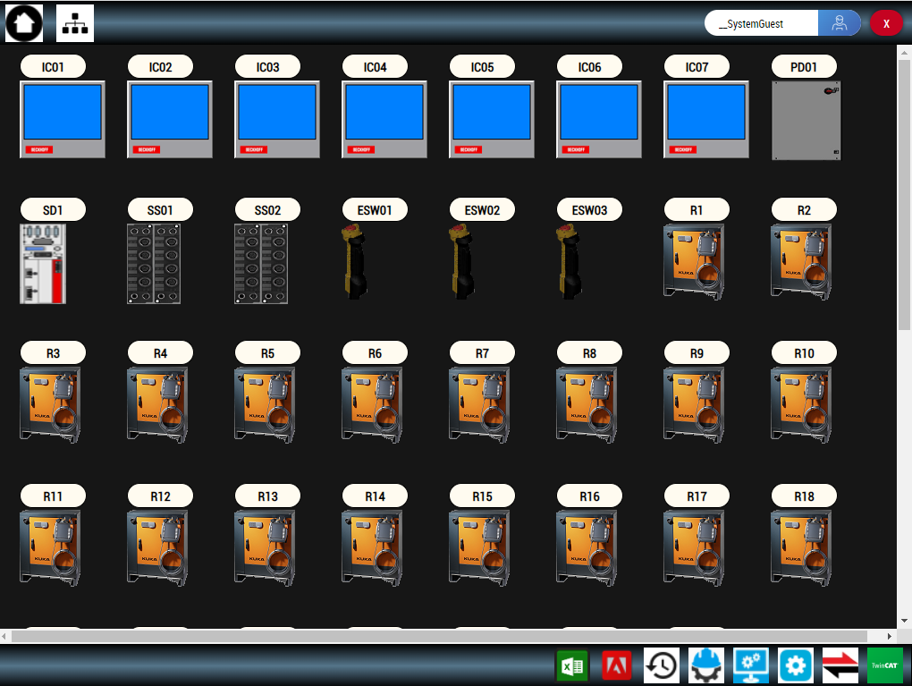
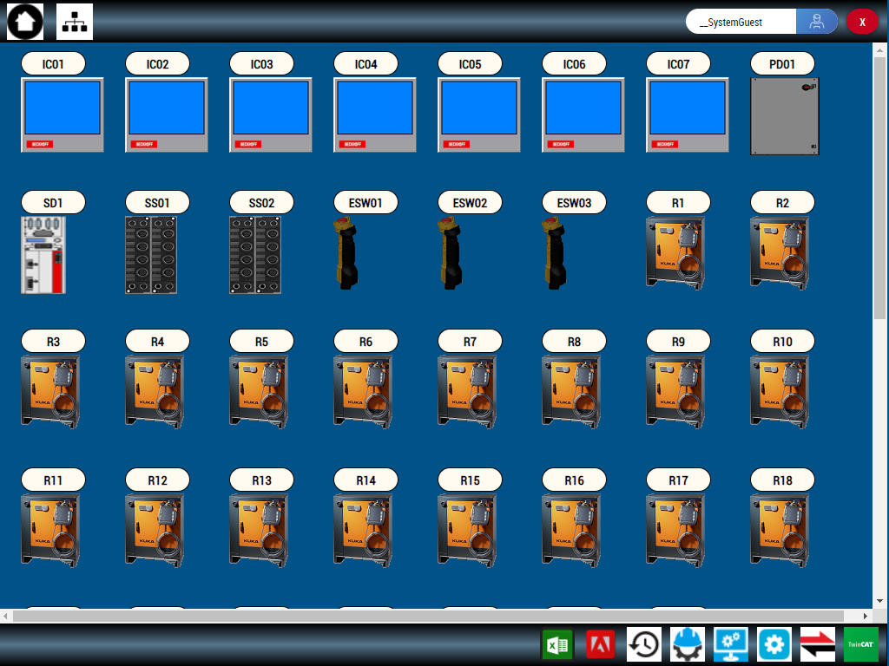

User Customizable Themes
On-Board Database for Production / Part Report Data
New features to be included in first release

Slide 8
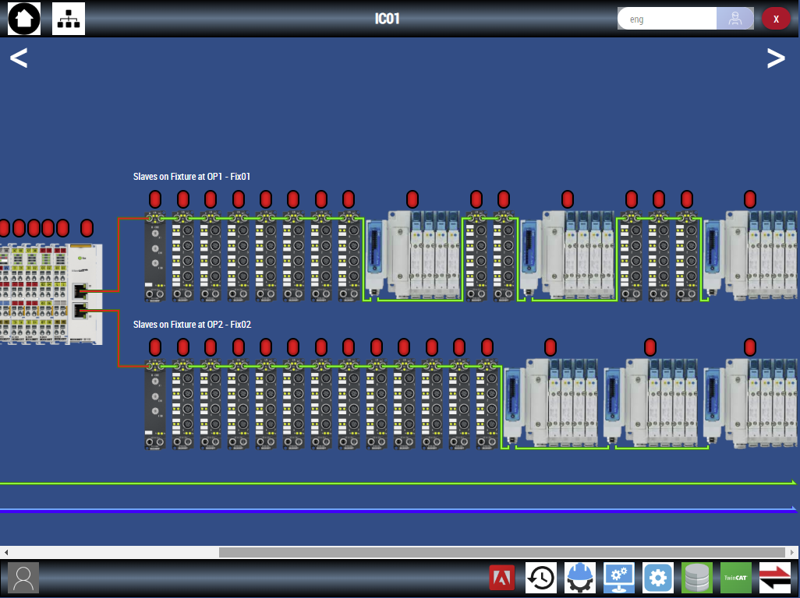
Like our standard GTAC Component screens, Fixture I/O nodes items will now auto configure on screen, saving deployment time
New features to be included in first release

Slide 9
Diving In
Let’s have a look…..

Slide 10
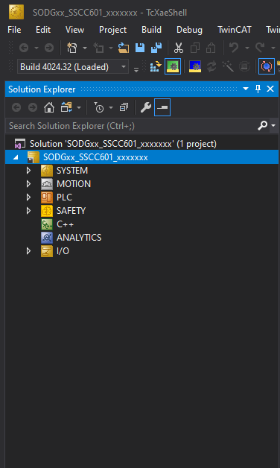
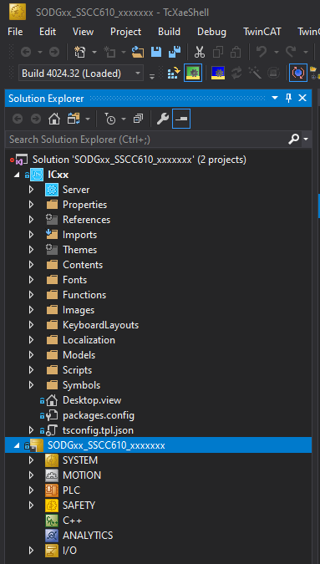
No TcHmi Project
With TcHmi Project

Slide 11
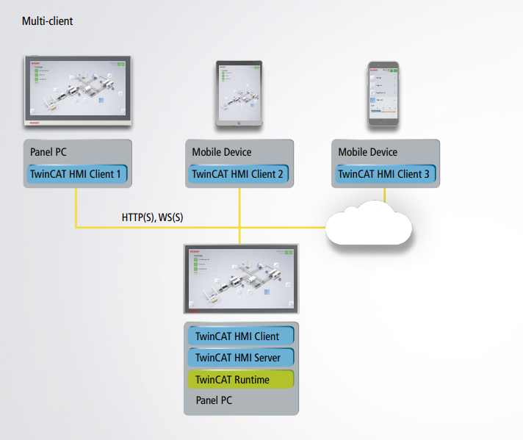
Web Based

Slide 12
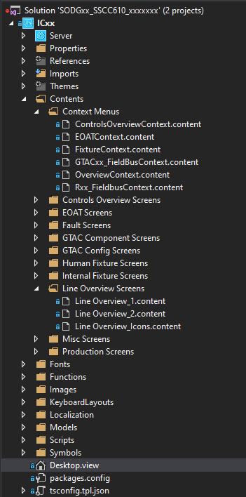
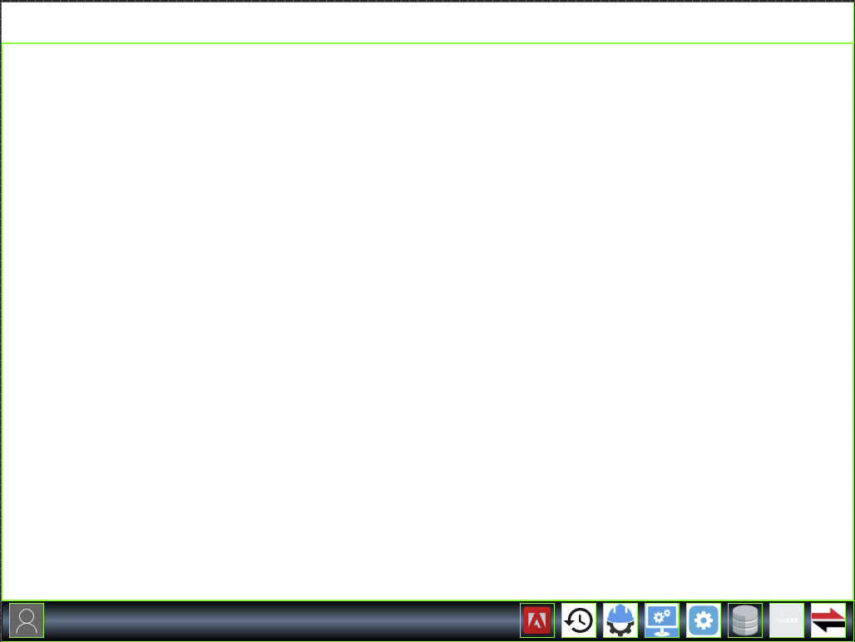
Navigation Concept
Context Region
Main Region

Slide 13
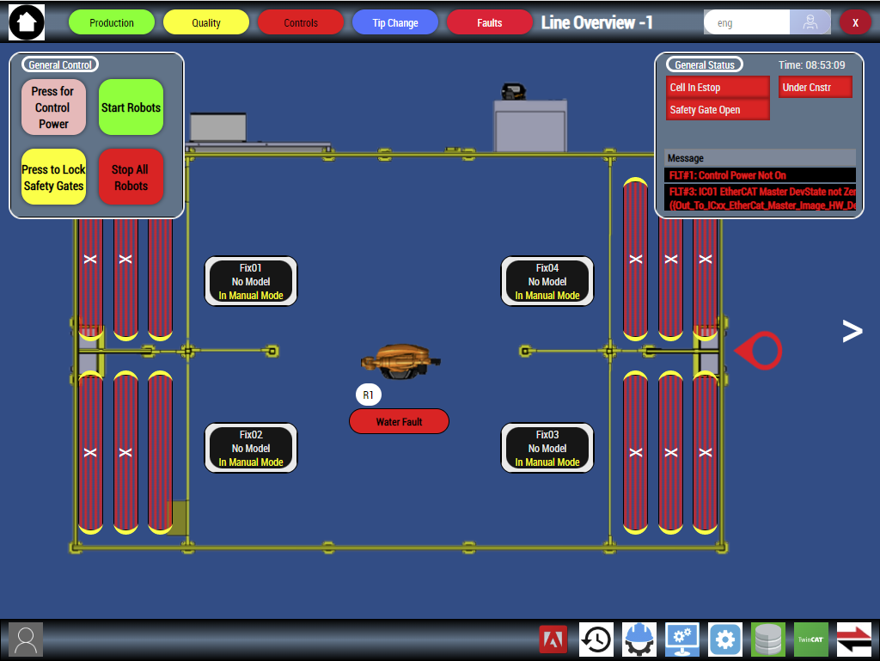
Navigation Concept

Slide 14
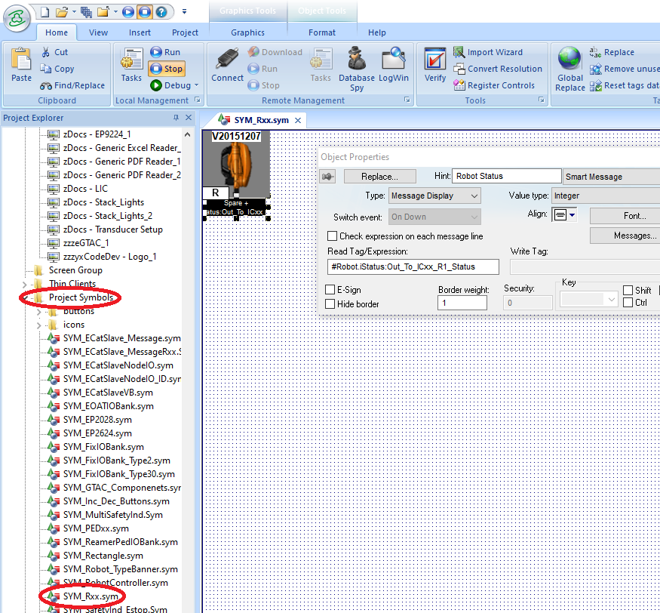
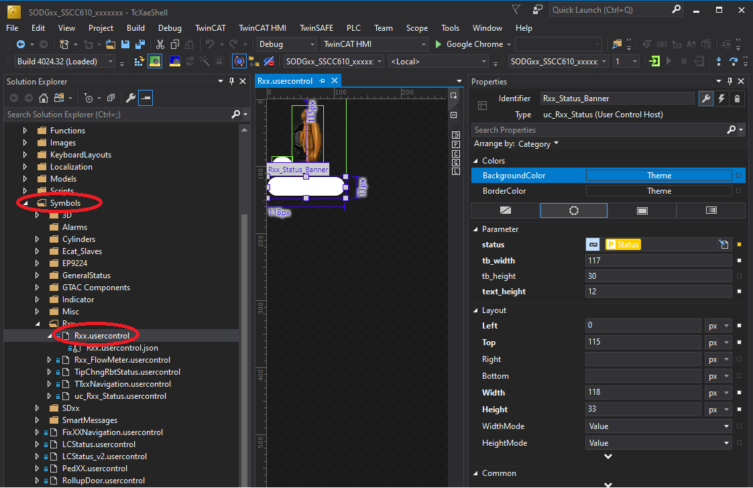
Symbols

Slide 15
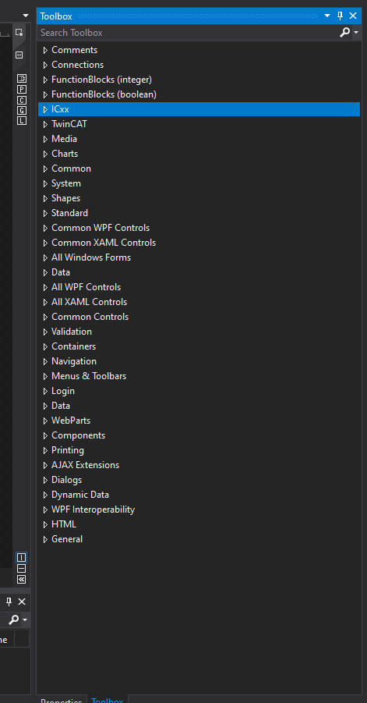
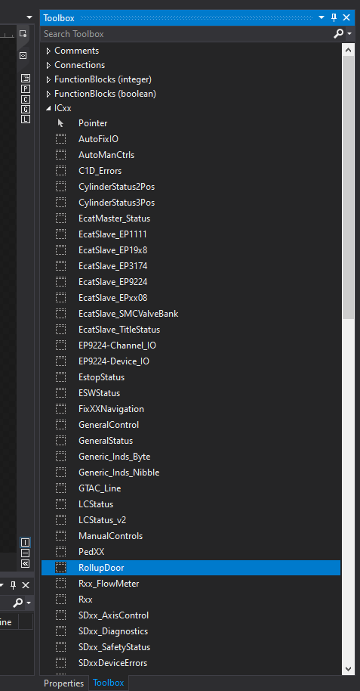
Symbols

Slide 16
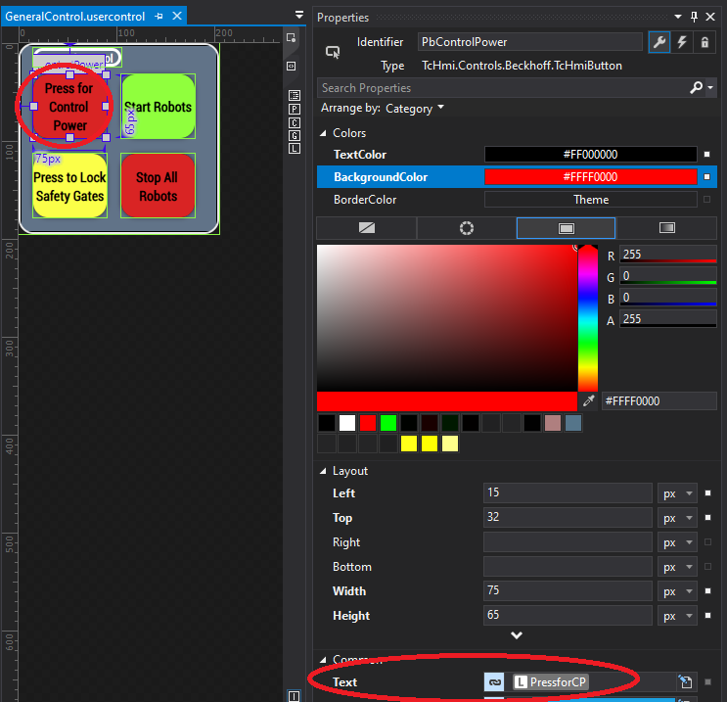
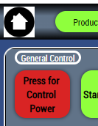
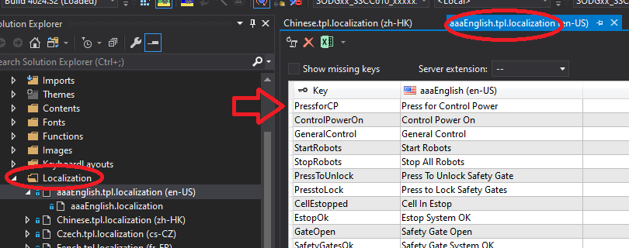
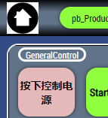
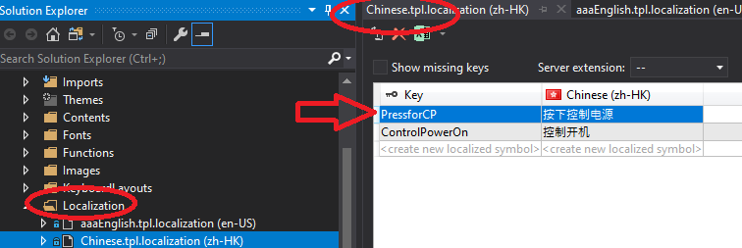
Localizations

Slide 17
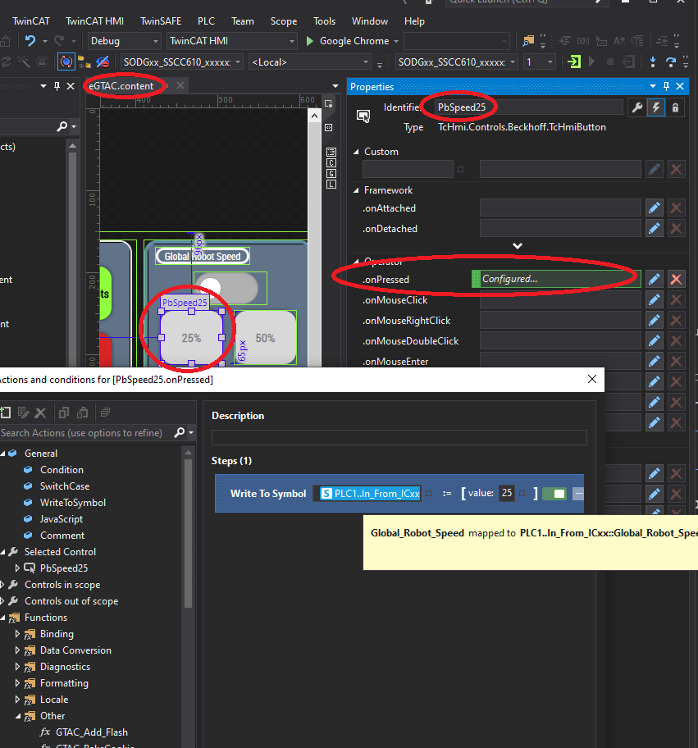
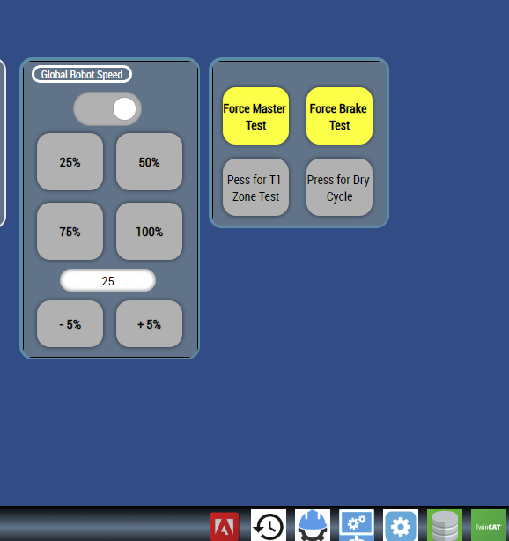
Action Editor

Slide 18
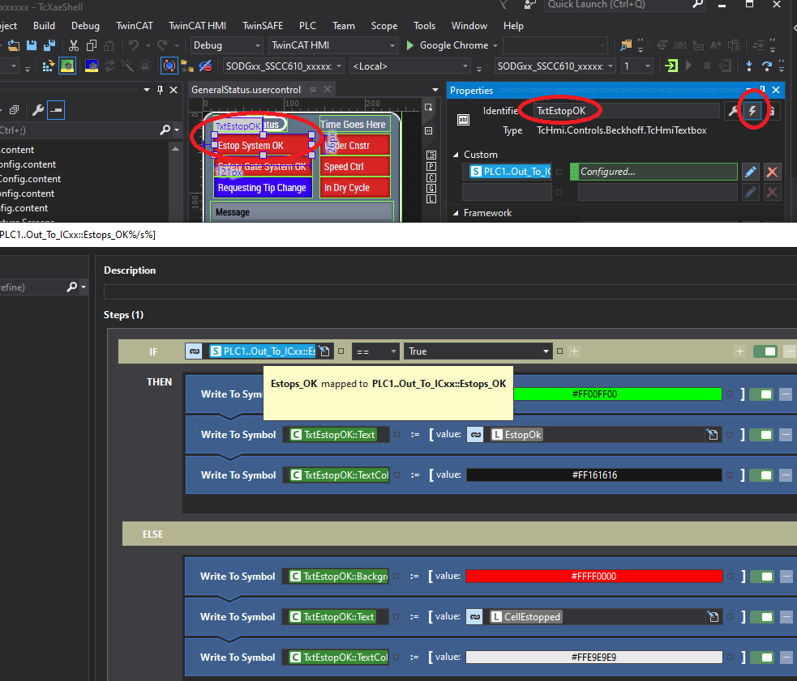
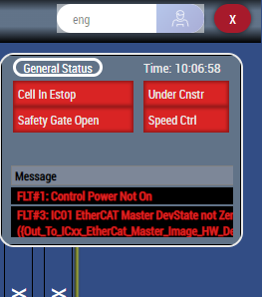
Action Editor

Slide 19
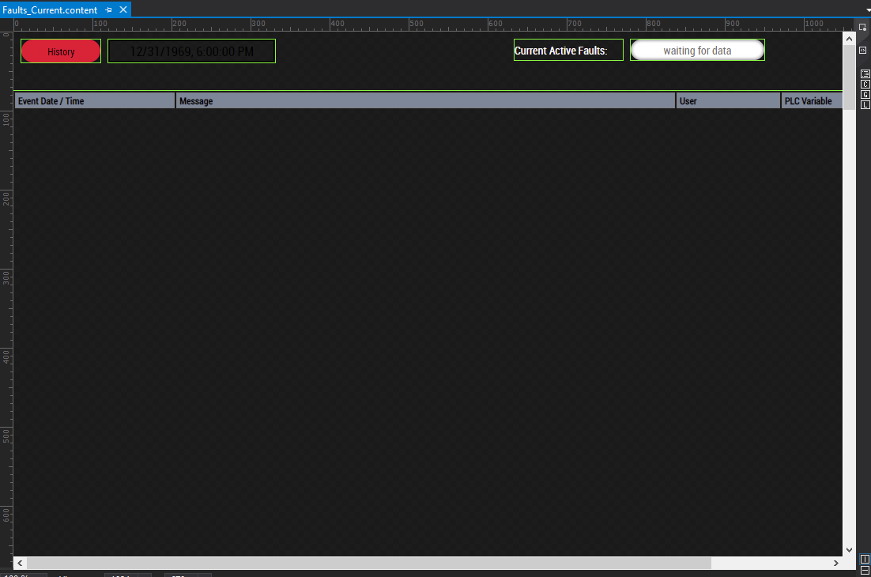
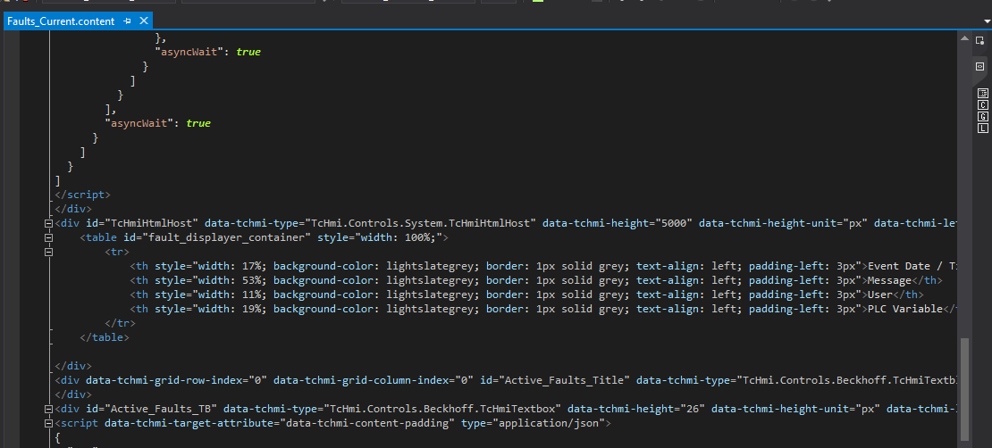
HTML / CSS
https://www.w3schools.com/html/default.asp

Slide 20
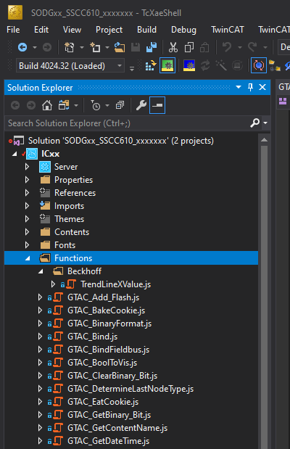
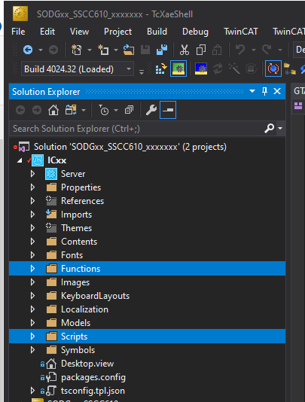
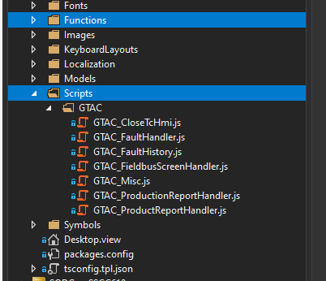
JavaScript
https://www.w3schools.com/js/default.asp

Slide 21
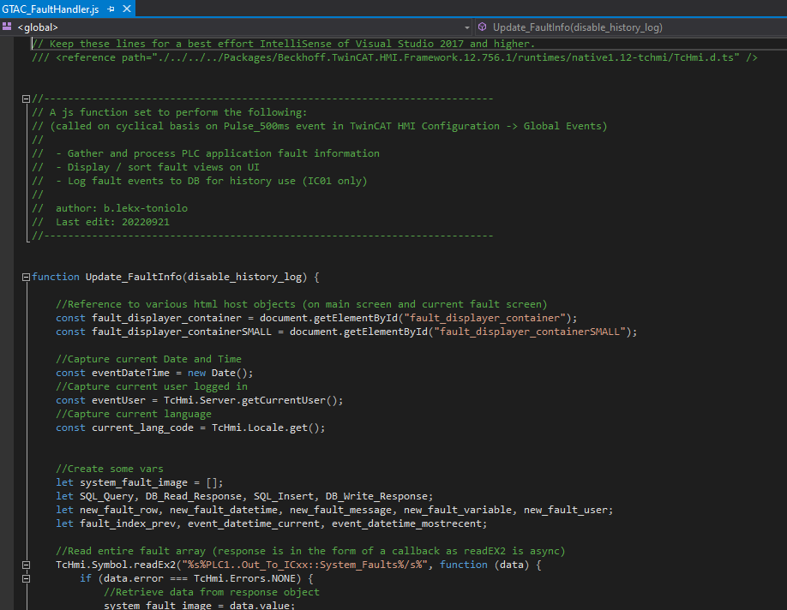
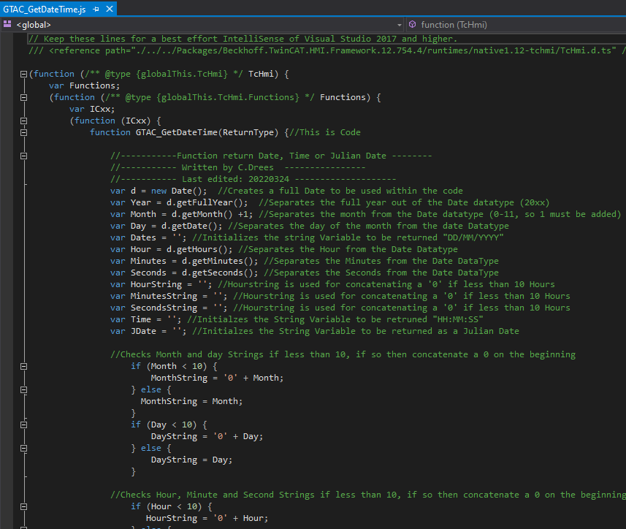
JavaScript
https://www.w3schools.com/js/default.asp

Slide 22





JavaScript

Slide 23
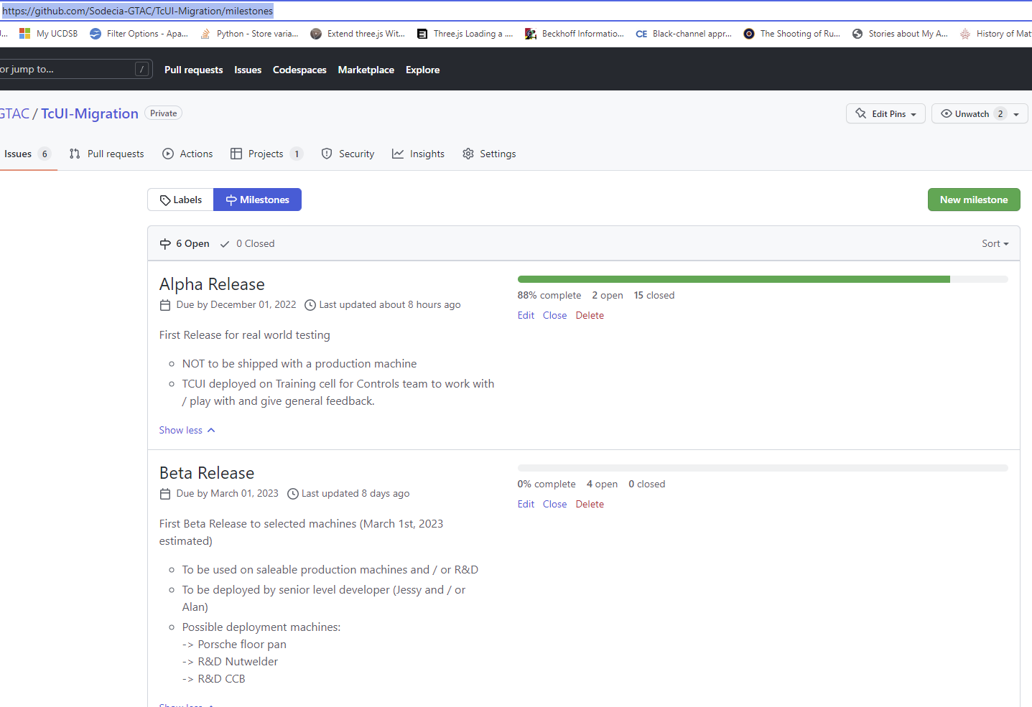
https://github.com/Sodecia-GTAC/TcUI-Migration/milestones

Slide 24

So far so good?
What’s next?
Questions

Slide 25

Thanks for your time

